Slide 1

INNOVATIVE & UNIQUE

Slide 2

Aston is a leading fibre optic products manufacturer and supplier.
We specialise in the manufacture of Fibre and Copper, Communication and Networking Products for bespoke and general applications.
Products range from basic passive infrastructure to active categories, including FTTH (fibre to the home), which is the new forefront in home entertainment and MTP solutions.
Currently selling into countries throughout the world..
Headquarters based in London, UK.

Slide 3
Quality Assurance
Being ISO 9001 registered verifies that our production facilities, methods, procedures and processes are in accordance with the International Organisation for Standardisation; the preferred solution for millions of organisations worldwide.
You can do business with Aston knowing that all aspects of how business is conducted is documented and in line with stringent, internationally recognised standards.

Slide 4
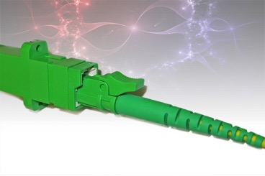
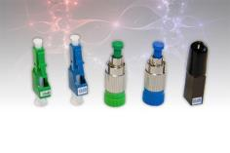
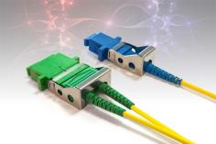
PRODUCTS
CONNECTORS, ADAPTERS
And ATTENUATORS
An optical fibre connector terminates the end of an optical fibre, and enables quicker connection and disconnection than splicing.
Various adapter configurations, including keystone, shuttered, and secure-lock (pictured).
Attenuators reduce the power of a signal without distorting its waveform.
Available in E2000, FC, LC, MPO/MTP, MTRJ, MU, SC and ST configurations.

Slide 5
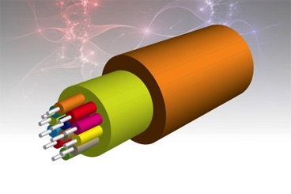
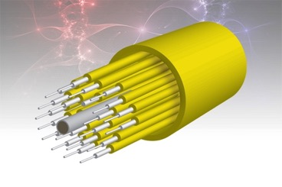
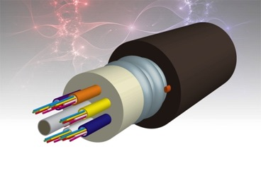
PRODUCTS
CABLE
Used to transmit optical signal in various environments.
Low smoke zero halogen jackets for safety.
TIGHT BUFFERED (900micron with aramid yarn. Vertical and Horizontal indoor application).
LOOSE TUBE (250micron, central tube with gel. Horizontal indoor/outdoor application).
Steel Tape or Wire Armoured (STA or SWA) option for added protection from rodents or external pressures.

Slide 6
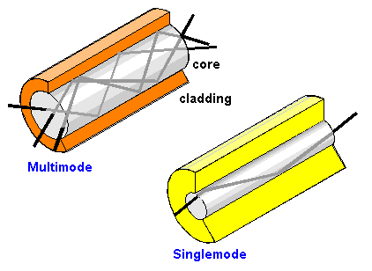

PRODUCTS
SINGLE MODE
CABLE
Single mode optical fibre is characterised by its narrow modal dispersion (8.3 to 10 micron diameter)
Better at retaining fidelity of light pulses and exhibiting higher bandwidth than multi mode
As a result, single mode fibre is ideal for long distance applications.
OS2

Slide 7
PRODUCTS
MULTI MODE
CABLE
Multi mode optical fibre is suitable for communication over short distances; such as in an office building or school.
Multi mode fibre equipment is cheaper than single mode
Due to its high capacity and reliability, multi mode fibre is ideal for backbone applications.
OM1, OM2, OM3, OM4

Slide 8
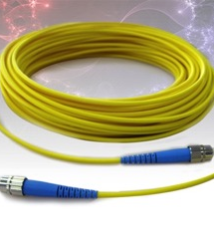
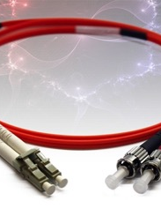
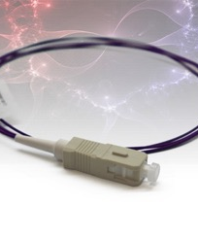
PRODUCTS
PATCH CORDS
AND PIGTAILS
Used to transmit optical signal, in simplex, duplex and different lengths
Available SINGLE MODE (higher bandwidth for long distance) and MULTI MODE (short distance for office backbones)
Pigtails are similar to patch cords, but only have one connector, and bare fibre on the other end.

Slide 9
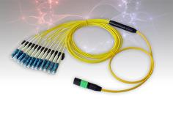
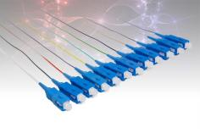
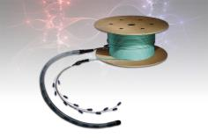
PRODUCTS
PRETERMINATED CABLES
AND MPO/MTP
Use of the high density MTP/MPO system allows for simple termination of the fibre backbone
Allows quick connection of up to 24 fibres by using the patented US Conec connectors.
Preterminated cable allows “plug and play” connectivity, reducing both labour and time for engineers.

Slide 10
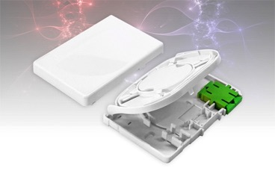
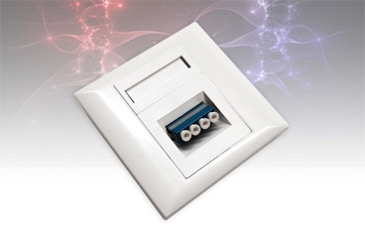
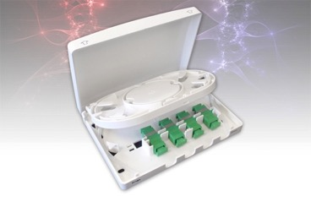
PRODUCTS
(FTTH)
FTTH is the installation and use of optical fibre from a central point directly to individual buildings such as residences, apartment buildings and businesses.
Fibre To The Home delivers the next generation of broadband Internet access.
A range of FTTH boxed and outlets, supplied loaded or unloaded.

Slide 11
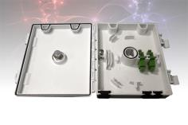
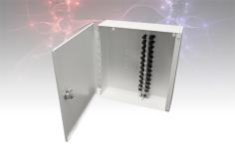
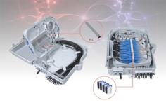
PRODUCTS
FTTH IP-RATED
WALL BOXES
We supply a range of wall boxes, in various sizes and IP ratings.
A great solution for fibre termination, in a range of configurations e.g. 12 fibre, 24 fibre etc.
Various lockable options and solid construction for security

Slide 12
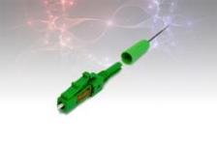

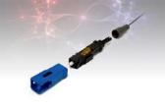
PRODUCTS
FIELD INSTALLABLE CONNECTORS
The Field Installable Connector is a pre-polished and pre-assembled connector that holds a fibre in place and can be installed within 2 minutes
A small case of tools is all that is needed

Slide 13

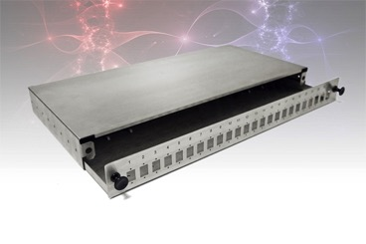
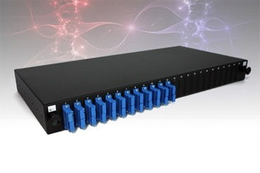
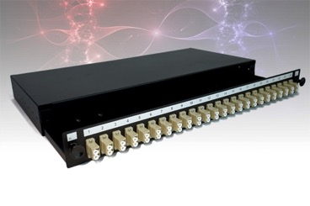
PRODUCTS
PATCH PANELS
Available in a range of connector configurations, loaded or unloaded.
19inch wide, and available in different heights: 1U, 2U etc.
Black powder coat finish, or stainless steel

Slide 14
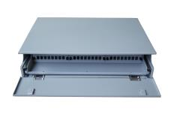
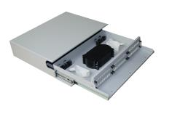
PRODUCTS
ODF
Optical distribution frames feature modulated design with drawable trays inside and constructed from cold-rolled steel.
Available unloaded or pre-installed with your choice of fibre optic adapters and pigtails
19inch wide, and available in different heights: 2U, 3U etc.
Durable powder coated finish.
An interchangeable face plate and cable management on some models

Slide 15
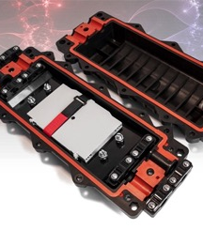
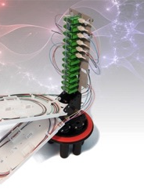
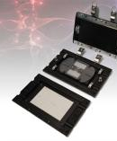
PRODUCTS
CLOSURES
Durable, strong IP68 rated closures for harsh environments.
Dome type, horizontal type, and compact type
Aerial, underground, wall mounting, duct mounting and manhole mounting. The ambient temperature ranges from -40°C to +65°C
Supplied with fibre management trays

Slide 16
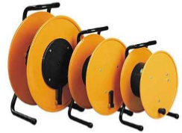
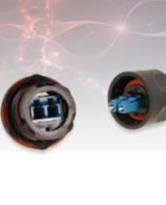
PRODUCTS
BROADCAST
A comprehensive range of products suitable for the broadcast industry:
Harsh Environment LC Connector Assemblies: water-resistant LC connector assemblies are an important solution in harsh environments. Ours are IP67 rated & salt-mist, humidity- and dust-proof and are lightweight, with a hard metal housing
Customised preterms made on compact 100% dielectric military tactical cable and supplied on redeployable reels: with excellent mechanical resistance, high flexibility, protection against moisture and UV resistant

Slide 17
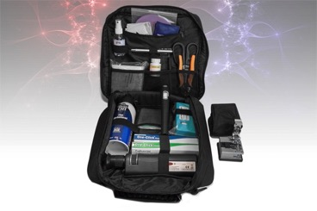
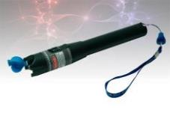
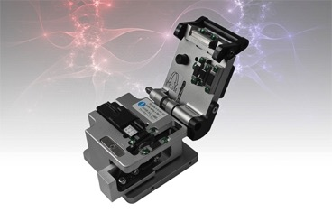
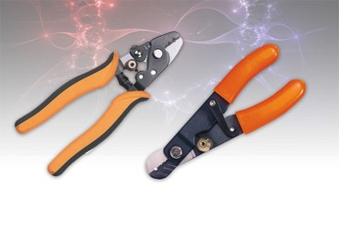
PRODUCTS
TOOLS, CLEANING, CONSUMABLES AND MORE

Slide 18
Thank You !!

